Slide 1
Synthetic Network Traffic Anomaly Detection
By: Rosemarie Kpaka

Slide 2
Agenda
Introduction
Problem Statement
Methodology
Results
Conclusion

Slide 3
Introduction
Network traffic analysis is crucial for identifying cybersecurity threats.
Detecting anomalies helps prevent potential attacks and breaches.
Objective: Build a machine learning model to classify normal vs. anomalous traffic.

Slide 4
Problem Statement
Cybersecurity threats are increasing, making anomaly detection essential.
Traditional methods may struggle with complex and large datasets.
This project aims to leverage machine learning for improved anomaly detection.

Slide 5
Dataset Overview
Source: Synthetic network traffic dataset.
Features include:
Source IP
Destination IP
Source Port
Destination Port
Protocol
Bytes Sent
Bytes Received
Packets Sent
Packets Received
Duration
Target Variable: IsAnomaly (1 for anomaly, 0 for normal)

Slide 6
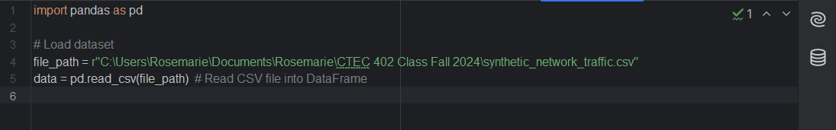
Data Loading
Loaded dataset using Pandas.
File path:
C:\Users\Rosemarie\Documents\Rosemarie\CTEC 402 Class Fall 2024\synthetic_network_traffic.csv

Slide 7
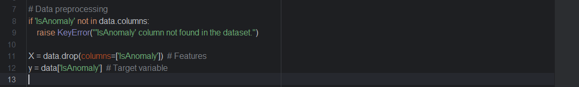
Data Preprocessing
Dropped the target column 'IsAnomaly' from features.
Standardized feature values for improved model performance.
Split data into training (80%) and test sets (20%).

Slide 8
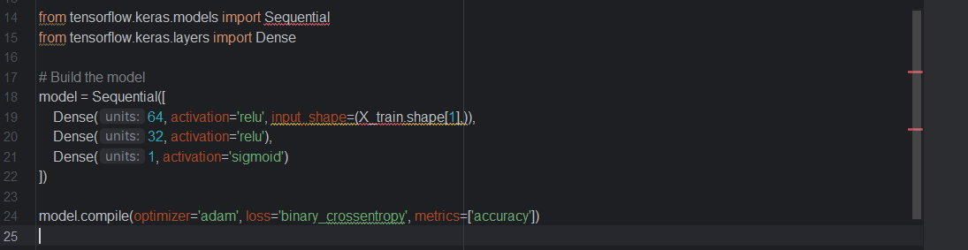
Model Architecture
Neural network model structure:
Input layer: 64 neurons, ReLU activation.
Hidden layer: 32 neurons, ReLU activation.
Output layer: 1 neuron, Sigmoid activation.

Slide 9
Model Compilation
Optimizer: Adam
Loss function: Binary cross-entropy
Metrics: Accuracy

Slide 10
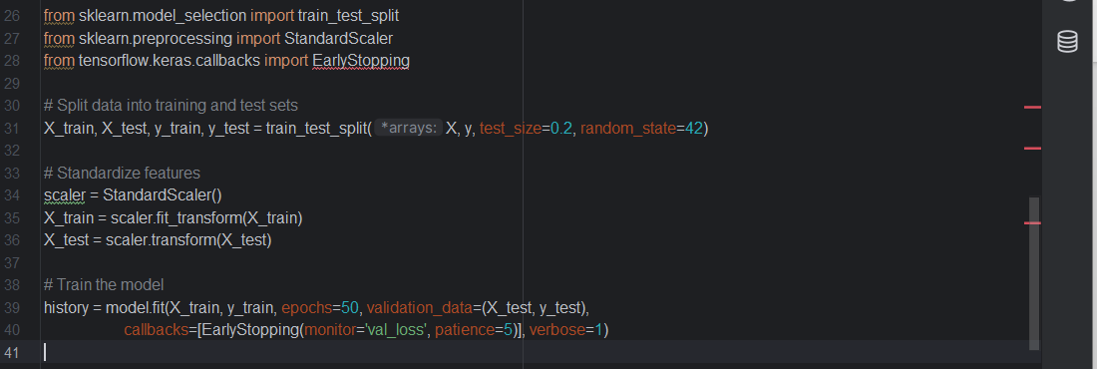
Training the Model
Training process details:
Number of epochs: 50
Early stopping implemented to prevent overfitting.
Validation data was used during training for performance monitoring.

Slide 11
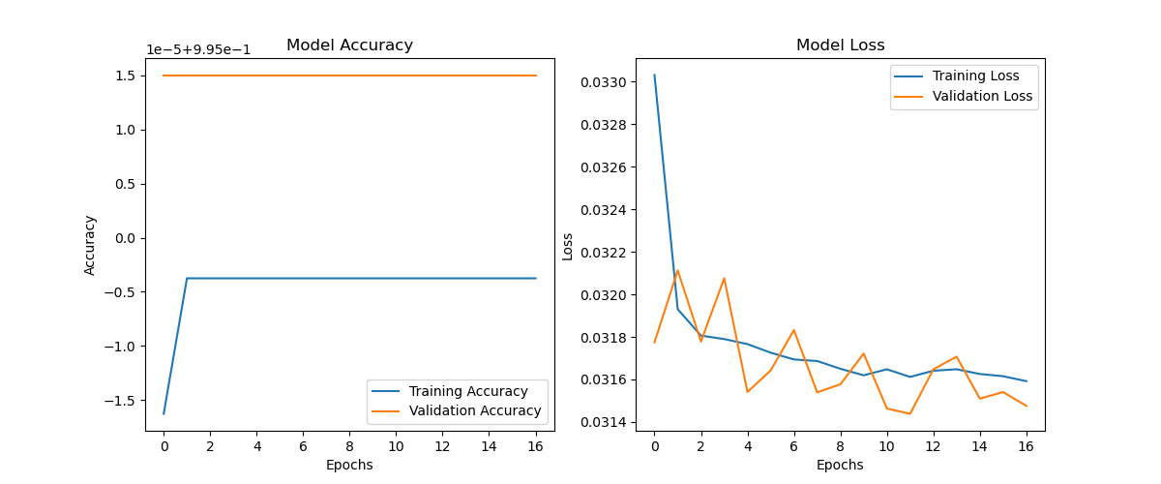
Training Results
The model showed improvement in accuracy over epochs.
Observed a decrease in loss during training.

Slide 12
Model Evaluation
Evaluation metrics included test accuracy and loss.
High accuracy indicates effective model performance in detecting anomalies.

Slide 13
Accuracy and Loss Plots
Display accuracy and loss plots (include visuals).
Accuracy plot shows model performance over epochs.
Loss plot indicates model learning and error reduction.

Slide 14
Key Findings
The model effectively detects network anomalies.
Machine learning provides significant advantages in cybersecurity.

Slide 15
Challenges Faced
Data quality and preprocessing presented initial challenges.
Model tuning was necessary to achieve optimal performance.

Slide 16
Future Work
Potential improvements:
Experiment with different algorithms (e.g., decision trees, ensemble methods).
Use more complex datasets for enhanced training.
Fine-tune hyperparameters for better results.

Slide 17
Conclusion
Recap of objectives: Develop an effective anomaly detection model.
Highlighted the significance of the project in enhancing cybersecurity.

Slide 18
Thank you to the collaborators and mentors who supported this project.
By: Rosemarie Kpaka

